Slide 1
Day 4 TABLEAU -MAP
- Mamatha Ramanujam

Slide 2
Map
Map based insights provide special significance .
Geographical elements associated with maps
Tableau provides extensive functionality using which we can create map based analysis.
Provide a solution for reporting and analyzing geographic data.

Slide 3
Scenario
1.Create a map view to represent all state with country
2.Check your map for south region
3.Check the sales for your south region
4.Represent your sales in USD
5.Edit the colour of your map
6.Show profit profile for all the state in south region
7.Find out the name of some state in negative profit

Slide 4
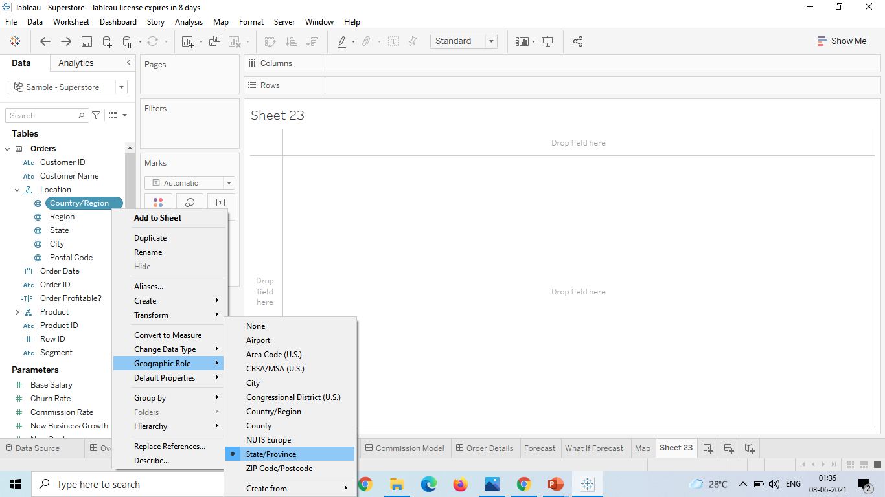
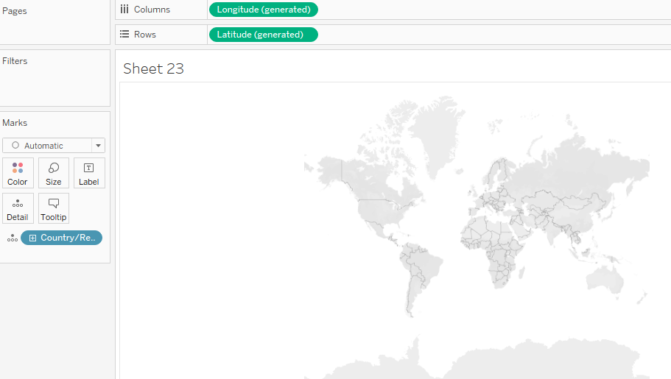
Create a map view to represent all state with country
Step1: After data loading on the Location select the Geographical role to State/provision .
Drag the Country/Region now to the Marks card

Slide 5
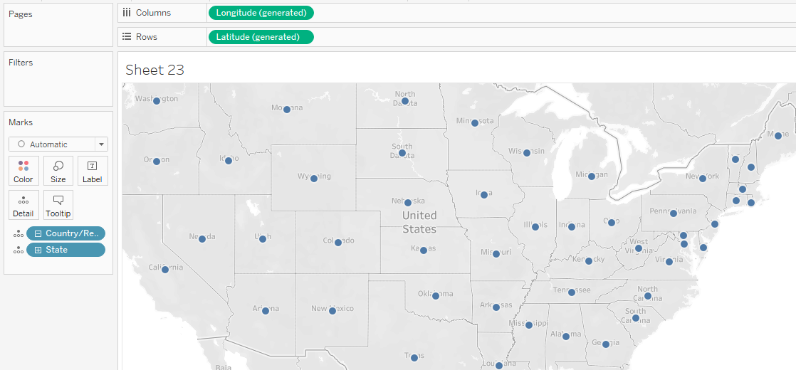
Step2: Drag the state dimension on detail in mark card and we get map based visualization as shown below.

Slide 6
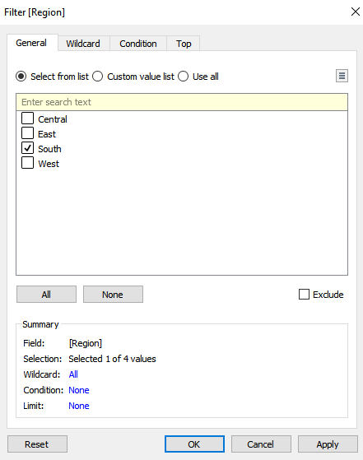
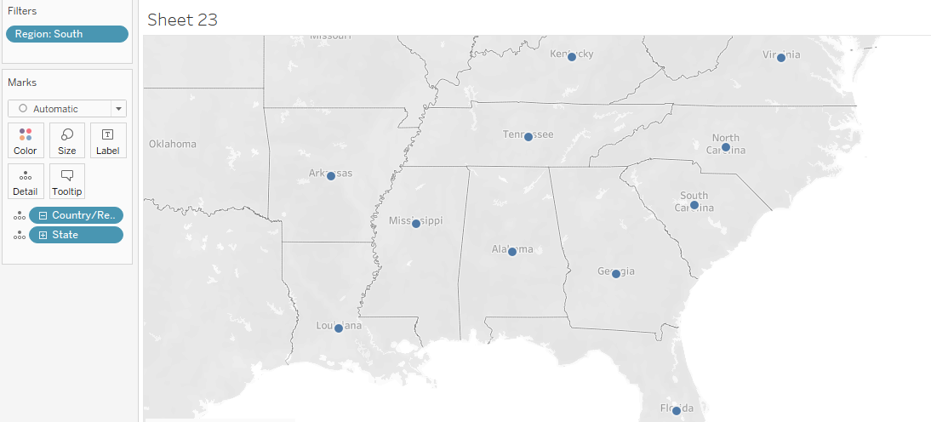
Check your map for south region
Step3: Drag the region dimension to filter and select the filter as “south” . Below is the visualization as shown

Slide 7
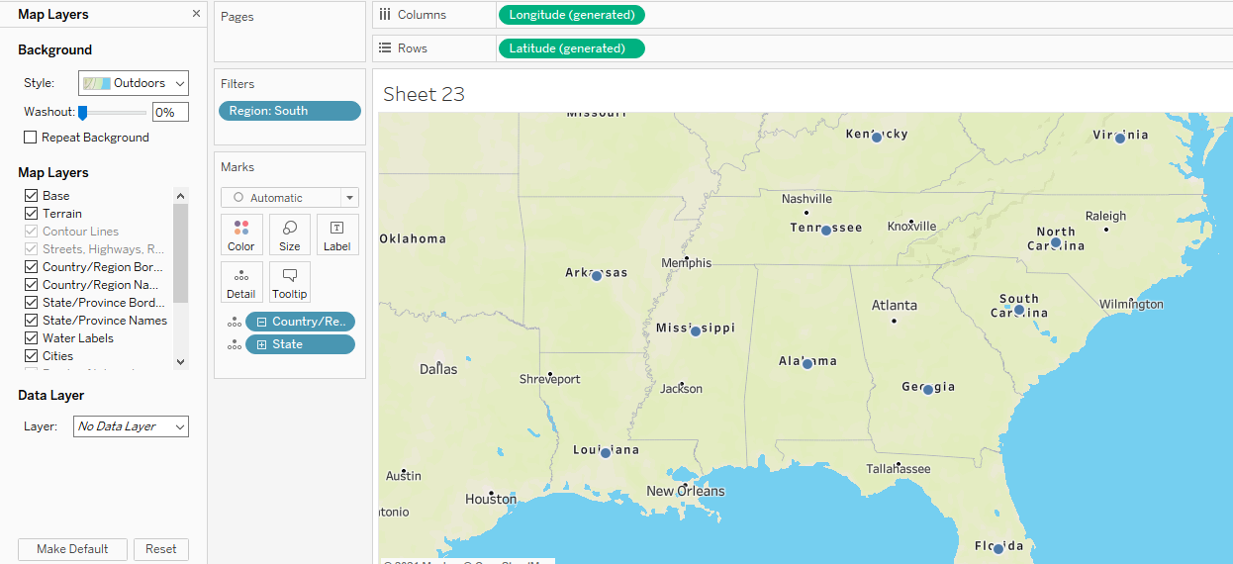
Map Layers
To change background , Map Layer , Data layer

Slide 8
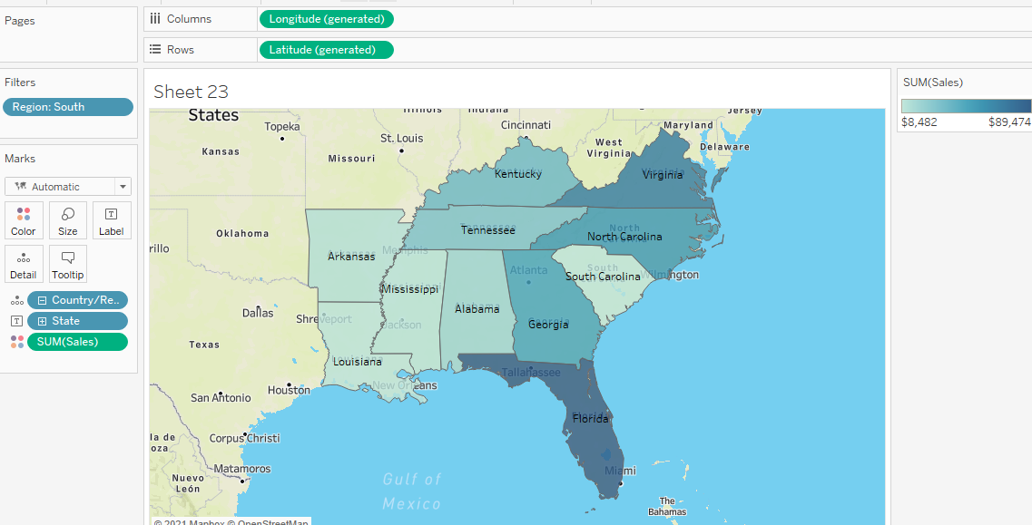
Check the Sales for south region
Drag/Double click the sales unit in Marks tab with colors option

Slide 9
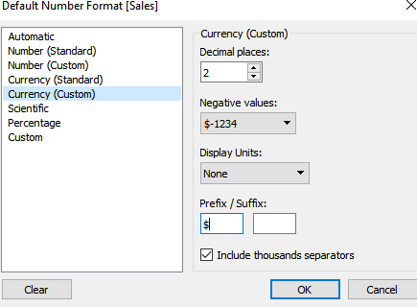
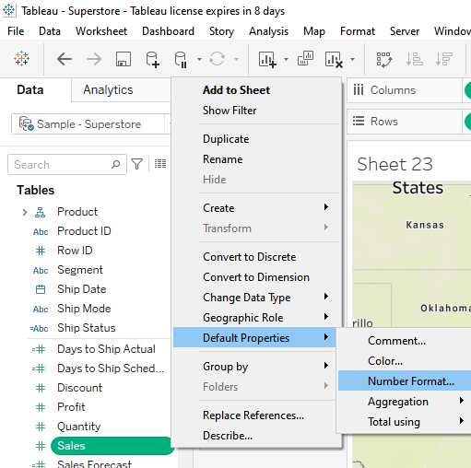
Represent your sales in USD
Step4: To change the currency format into $(dollar) right click Sales → Default properties→ Number format and in currency custom change as $

Slide 10
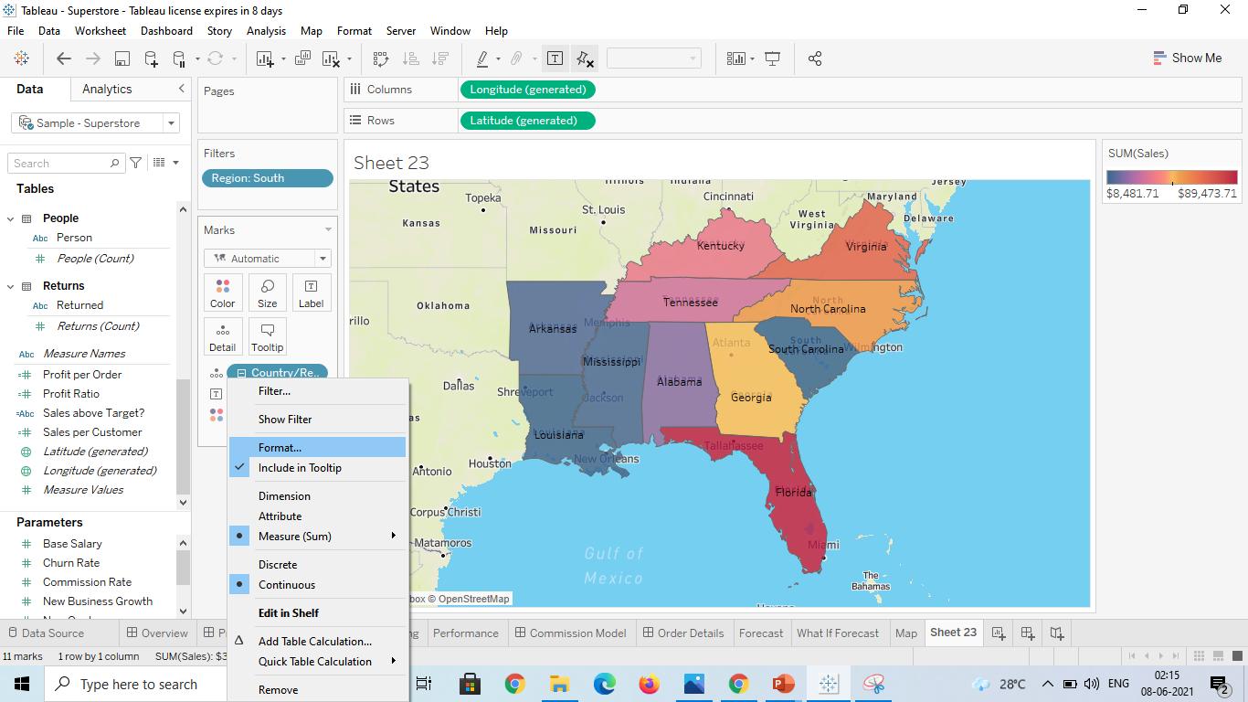
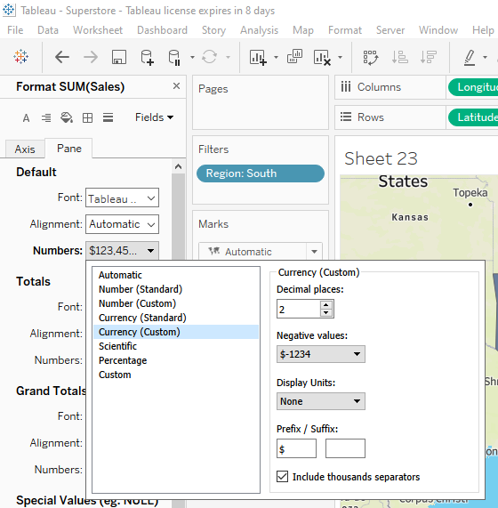
To change the currency format on the axis/pane on SUM(Sale)

Slide 11
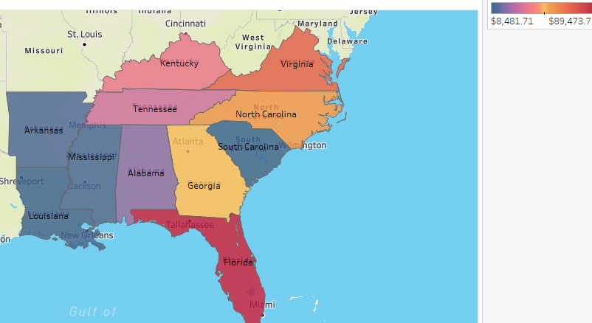
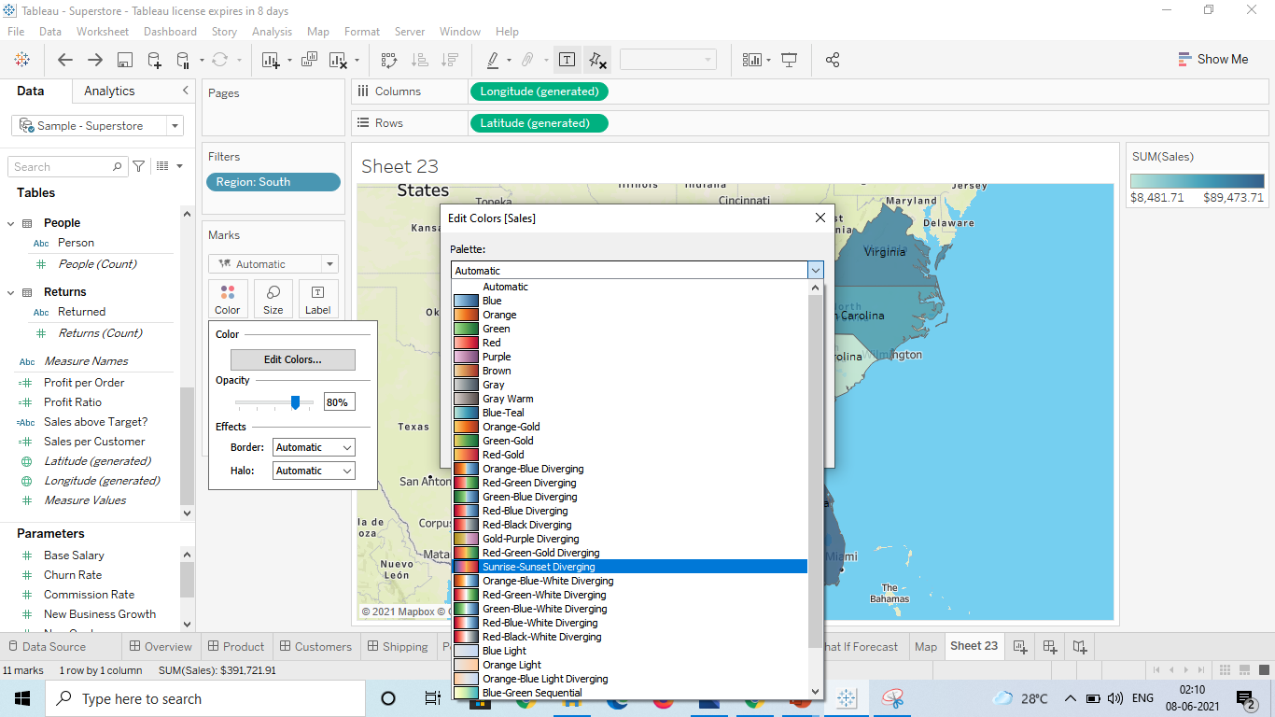
Edit color of your map
Step5: Select Colors →Edit colors→ Select color of preference

Slide 12
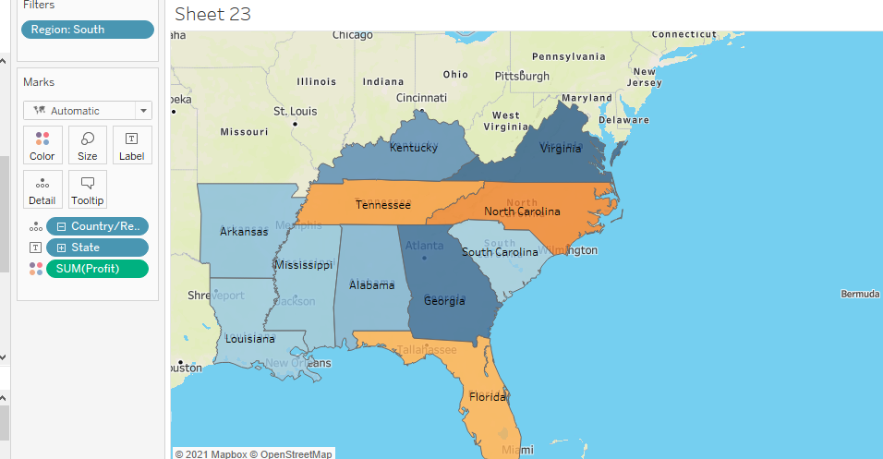
Show profit of all state in your map in south region
Step6: As we required to analyze profit remove the existing Sales unit and drag the Profit unit into Marks(Mode:Color)

Slide 13
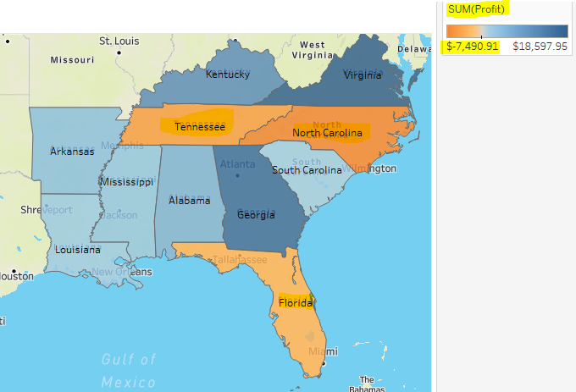
Find out the name of some state which has negative profit
From the analysis it is evident that
North Carolina($ -7,490.91) , Tenessee($ -5.341.69) , Florida($ -3,399.30) has the negative profit

Slide 14
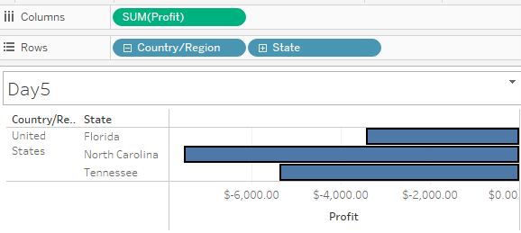

Slide 15
